Slide 1
EMTH403
Mathematical Foundation for Computer Science

Slide 2
Lecture Outcomes
understand what truth value of the existential quantification.
express the compound proposition with existential quantification in English.
understand how to write compound proposition with existential quantification using disjunctions, conjunctions, and negations

Slide 3
Quantifiers
Many mathematical statements assert that there is an element with a certain property.
Such statements are expressed using existential quantification.
With existential quantification, we form a proposition that is true if and only if P(x) is true for at least one value of x in the domain.

Slide 4
Existential Quantifier
The existential quantification of P(x) is the proposition. “There exists an element x in the domain such that P(x).”
We use the notation ∃xP(x) for the existential quantification of P(x). Here ∃ is called the existential quantifier.

Slide 5
Quantifiers
A domain must always be specified when a statement ∃xP(x) is used.
Furthermore, the meaning of ∃xP(x) changes when the domain changes.
Without specifying the domain, the statement ∃xP(x) has no meaning.

Slide 6
Existential Quantifier
Besides the phrase “there exists,” we can also express existential quantification in many other ways, such as by using the words “for some,” “for at least one,” or “there is.”
The existential quantification ∃xP(x) is read as
  “There is an x such that P(x),”
  “There is at least one x such that P(x),”
  or
  “For some xP(x).”

Slide 7
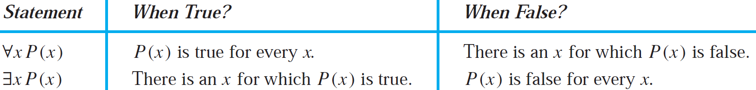
Existential Quantifier
The meaning of the existential quantifier is summarized in the second row of Table. We illustrate the use of the existential quantifier in following examples.

Slide 8
Existential Quantifier – Example - 1
Ques:- Let P(x) denote the statement “x > 3.” What is the truth value of the quantification ∃xP(x), where the domain consists of all real numbers?
Ans:- Because “x > 3” is sometimes true—for instance, when x = 4—the existential quantification of P(x), which is ∃xP(x), is true.

Slide 9
Existential Quantifier
Observe that the statement ∃xP(x) is false if and only if there is no element x in the domain for which P(x) is true.
That is, ∃xP(x) is false if and only if P(x) is false for every element of the domain.

Slide 10
Existential Quantifier – Example - 2
Ques:- Let Q(x) denote the statement “x = x + 1.”What is the truth value of the quantification ∃xQ(x), where the domain consists of all real numbers?
Ans:- Because Q(x) is false for every real number x, the existential quantification of Q(x), which is ∃xQ(x), is false.

Slide 11
Existential Quantifier
Remark:
  Generally, an implicit assumption is made that all domains of discourse for quantifiers are non-empty.

Slide 12
Existential Quantifier
If the domain is empty, then ∃xQ(x) is false whenever Q(x) is a propositional function because when the domain is empty, there can be no element x in the domain for which Q(x) is true.

Slide 13
Existential Quantifier
Remark: When all elements in the domain can be listed—say, x₁, x₂, . . . , x_{n}—the existential quantification ∃xP(x) is the same as the disjunction
P(x₁) ∨ P(x₂) ∨ · · · ∨ P(x_{n}),
because this disjunction is true if and only if at least one of P(x₁), P(x₂), . . . , P (x_{n}) is true

Slide 14
Existential Quantifier – Example - 3
Ques:- What is the truth value of ∃xP(x), where P(x) is the statement “x² > 10” and the universe of discourse consists of the positive integers not exceeding 4?
Ans:- Because the domain is {1, 2, 3, 4}, the proposition ∃xP(x) is the same as the disjunction
P(1) ∨ P(2) ∨ P(3) ∨ P(4).
Because P(4), which is the statement “4² > 10,” is true, it follows that ∃xP(x) is true.

Slide 15
Existential Quantifier – Example - 4
Ques:- Determine the truth value of each of the statement ∃n(n = −n) if the domain consists of all integers.
Ans:- This statement is true, since 0 = -0.

Slide 16
Existential Quantifier – Example - 5
Ques:- Determine the truth value of the statement ∃n(2n = 3n) if the domain consists of all integers.
Ans:- Since 2 · 0 = 3 · 0, this is true.

Slide 17
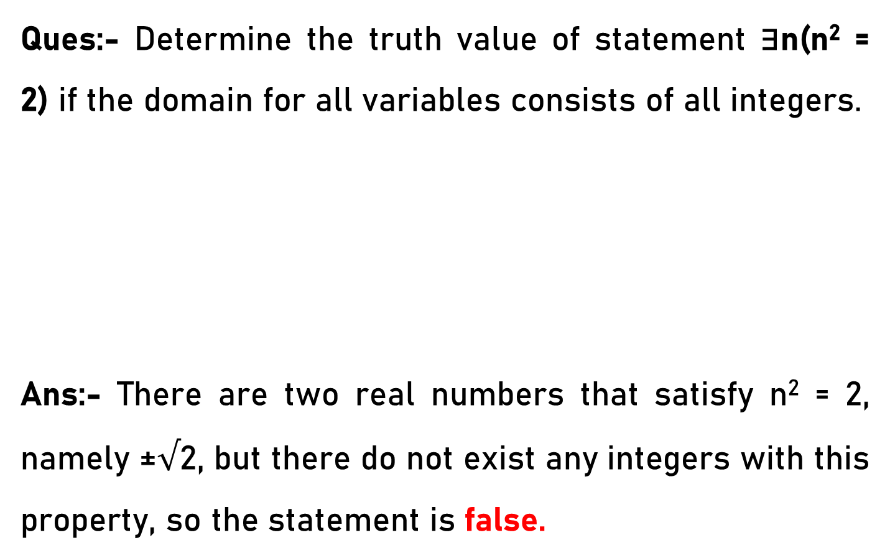
Existential Quantifier – Example - 6
Ques:- Determine the truth value of statement ∃n(n² = 2) if the domain for all variables consists of all integers.
Ans:- There are two real numbers that satisfy n² = 2, namely ±$√$2, but there do not exist any integers with this property, so the statement is false.

Slide 18
Existential Quantifier – Example - 7
Ques:- Let P(x) be the statement “x = x².” If the domain consists of the integers, what is the truth value of ∃xP(x)?
Ans:- T (let x = 1)

Slide 19
Existential Quantifier – Example - 8
Ques:- Determine the truth value of the statement ∃n(n² < 0) if the domain for all variables consists of all integers.
Ans:- Squares can never be negative; therefore this statement is false.

Slide 20
Existential Quantifier – Example - 1
Ques:- Let P(x) be the statement “x spends more than five hours every weekday in class,” where the domain for x consists of all students. Express the quantification ∃xP(x) in English.
Ans:- There is a student who spends more than five hours every weekday in class.

Slide 21
Existential Quantifier – Example - 2
Ques:- Let P(x) be the statement “x spends more than five hours every weekday in class,” where the domain for x consists of all students. Express the quantifications ∃x ¬P(x) in English.
Ans:- There is a student who does not spend more than five hours every weekday in class.

Slide 22
Existential Quantifier – Example - 3
Ques:- Translate the statement ∃x(C(x) → F(x)) into English, where C(x) is “x is a comedian” and F(x) is “x is funny” and the domain consists of all people.
Ans:- This statement is that there exists an x in the domain such that if x is a comedian then x is funny. In English, this might be rendered, "There exists a person such that ifs/he is a comedian, then s/he is funny.“

Slide 23
Existential Quantifier – Example - 4
Ques:- Translate the statement ∃x(C(x) ∧ F(x)) into English, where C(x) is “x is a comedian” and F(x) is “x is funny” and the domain consists of all people.
Ans:- This statement is that there exists an x in the domain such that x is a comedian and x is funny. In English, this might be rendered, ''There exists a funny comedian" or "Some comedians are funny" or "Some funny people are comedians."

Slide 24
Existential Quantifier – Example - 1
Ques:- Let P(x) be the statement “x can speak Russian” and let Q(x) be the statement “x knows the computer language C++.” Express the sentence “There is a student at your school who can speak Russian and who knows C++.” in terms of P(x), Q(x), quantifiers, and logical connectives. The domain for quantifiers consists of all students at your school.
Ans:- We assume that this sentence is asserting that the same person has both talents. Therefore, we can write ∃x(P(x) /\ Q(x)).

Slide 25
Existential Quantifier – Example - 2
Ques:- Let P(x) be the statement “x can speak Russian” and let Q(x) be the statement “x knows the computer language C++.” “There is a student at your school who can speak Russian but who doesn’t know C++.” in terms of P(x), Q(x), quantifiers, and logical connectives. The domain for quantifiers consists of all students at your school.
Ans:- Since "but" really means the same thing as "and" logically, this is ∃x(P(x) /\ ¬Q(x))

Slide 26
Existential Quantifier – Example - 3
Ques:- Suppose that the domain of the propositional function P(x) consists of the integers 0, 1, 2, 3, and 4. Write out each of the proposition ∃xP(x) using disjunctions, conjunctions, and negations.
Ans:- We want to assert that P(x) is true for some x in the universe, so either P(O) is true or P(1) is true or P(2) is true or P(3) is true or P(4) is true. Thus the answer is
P(O) V P(1) V P(2) V P(3) V P(4).

Slide 27
Existential Quantifier – Example - 4
Ques:- Suppose that the domain of the propositional function P(x) consists of the integers 0, 1, 2, 3, and 4. Write out the proposition ∃x¬P(x) using disjunctions, conjunctions, and negations.
Ans:- ¬P(O) V ¬P(1) V ¬P(2) V ¬P(3) V ¬P(4)

Slide 28
Existential Quantifier – Example - 5
Ques:- Suppose that the domain of the propositional function P(x) consists of the integers 1, 2, 3, 4, and 5. Express the statement ∃xP(x) without using quantifiers, instead using only negations, disjunctions, and conjunctions.
Ans:- We want to assert that P(x) is true for some x in the universe, so either P(1) is true, or P(2) is true, or P(3) is true, or P(4) is true, or P(5) is true. Thus, the answer is
P(1) V P(2) V P(3) V P(4) V P(5).

Slide 29
Existential Quantifier – Example - 6
Ques:- Suppose that the domain of the propositional function P(x) consists of the integers 0, 1, 2, 3, and 4. Write out the proposition ¬∀xP(x) using disjunctions, conjunctions, and negations.
Ans:- ¬(P(O) ∧ P(1) ∧ P(2) ∧ P(3) ∧ P(4))

Slide 30
Existential Quantifier – Example - 7
Ques:- Suppose that the domain of the propositional function P(x) consists of the integers 1, 2, 3, 4, and 5. Express the statement ¬∃xP(x) without using quantifiers, instead using only negations, disjunctions, and conjunctions.
Ans:- This is just the negation of part
¬(P(1) V P(2) V P(3) V P(4) V P(5))

